Slide 1
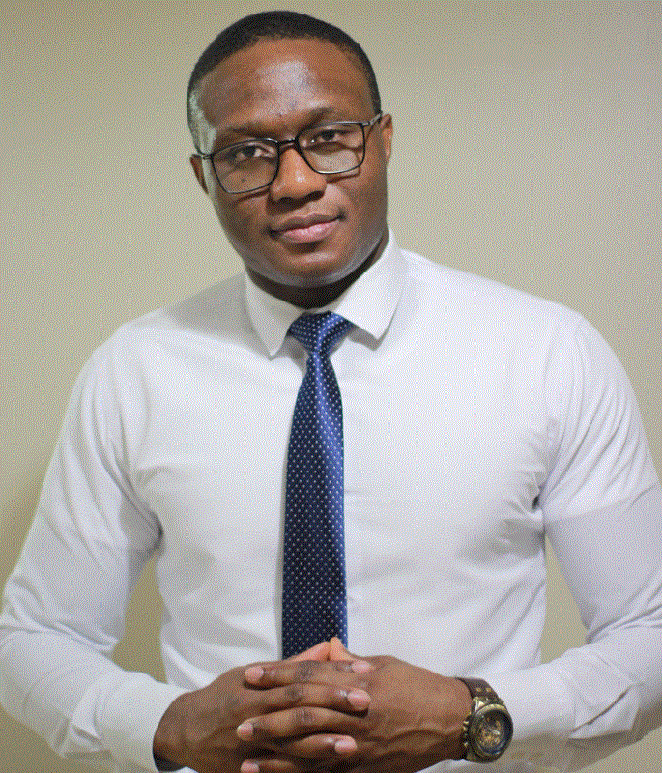
Albert Eromosele
TECHNICAL SUPPORT ENGINEER

Slide 2
Powershell For Administrators
Albert Eromosele
TECHNICAL SUPPORT ENGINEER

Slide 3





Slide 4
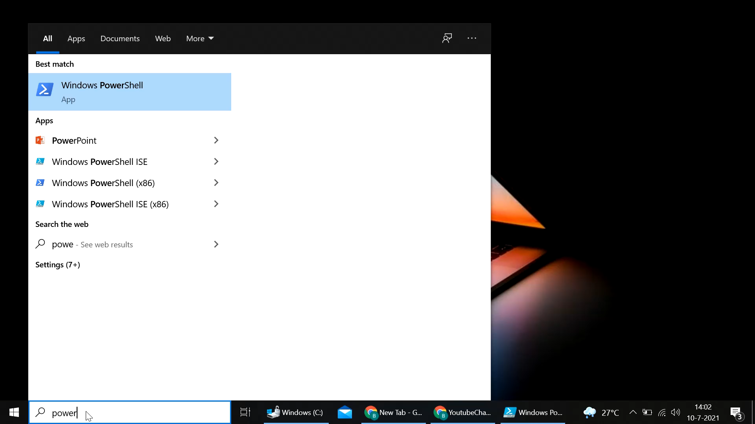
POWERSHELL

Slide 5
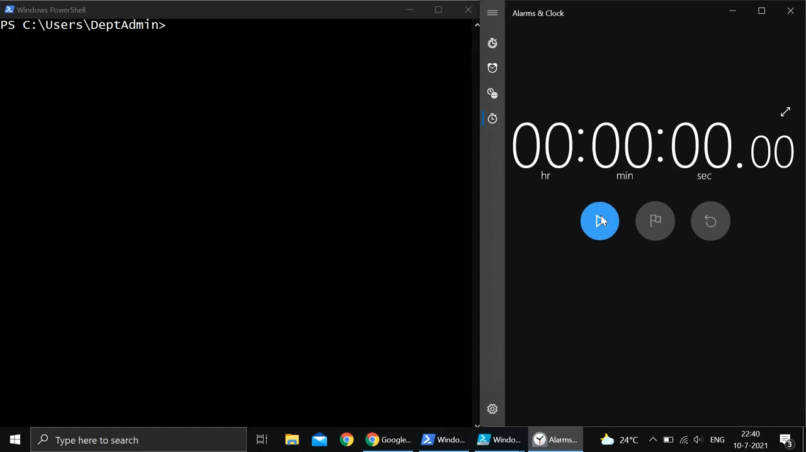
POWERSHELL

Slide 6
Albert Eromosele
IT SUPPORT TECH

Slide 7
Albert Eromosele
IT SUPPORT TECH

Slide 8
Powershell For Administrators
Albert Eromosele
TECHNICAL SUPPORT ENGINEER

Slide 9
Meet PowerShell

